Slide 1
Classroom-experiment
Nienke van der Wateren & Juliet Hoevers & Ruben de Mink
VWO 5

Slide 2
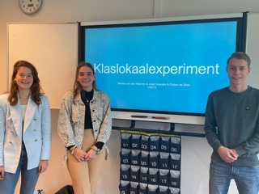
Introduction
Nienke van der Wateren
Juliët Hoevers
Ruben de Mink

Slide 3

Introduction
Ordinary insurance
No insurance
Bonus-malus

Slide 4

Experiment
Verzekeringen
Option 1:
No insurance: no premium
Option 2:
Bonus-malus
You start in scale 0
Damage? 2 scales down
No damage? 1 scale up
Minimum 2 weeks
Option 3:
Ordinary insurance
- Premium = 2 snoepjes per week
4 rounds /4 weeks
25 sweets to start with
Good to know:
1/6 chance of being robbed
12 sweets are the damage
After each round is it possible
to make a change
Schaal: | Premie (in snoepjes):
Schaal 2 | 1
Schaal 1 | 2
0 | 3
Schaal -1 | 4
Schaal -2 | 5
Schaal-3 | 6
Schaal-4 | 7
Schaal-5 | 8

Slide 5
Experiment round 1 & 2
Verzekeringen
Option 1:
No insurance: no premium
Option 2:
Bonus-malus
You start in scale 0
Damage? 2 scales down
No damage? 1 scale up
Minimum of 2 weeks
Option 3:
Ordinary insurance
- Premium = 2 sweets a week
Scale | Premium (in sweets):
Scale2 | 1
Scale 1 | 2
0 | 3
Scale-1 | 4
Scale -2 | 5
Scale -3 | 6
Scale -4 | 7
Scale -5 | 8

Slide 6
Round | What kind of insurance ? | Amount of sweets before paying the insurance | Amount of sweets after paying the insurance | Amount of sweets after paying the dice have been rolled | Which scale of the bonus malus –system are you in?
1 |  | 25
2
3
4

Slide 7
Verzekeringen
Round 1
Put either:
0, 2 or 3 sweets on the corner of the table
Optie 1:
Niet verzekeren
Optie 2:
Bonus-malus
Beginnen in schaal 0
Schade? Volgende ronde 2 schalen omlaag
Geen schade? Volgende ronde 1 schaal omhoog
Minimaal 2 weken!!
Optie 3:
Normale verzekering
- Premie = 2 snoepjes per week
Schaal: | Premie (in snoepjes):
Schaal 2 | 1
Schaal 1 | 2
0 | 3
Schaal -1 | 4
Schaal -2 | 5
Schaal-3 | 6
Schaal-4 | 7
Schaal-5 | 8

Slide 8
Verzekeringen
Round 1
Roll the dice!
Put the sweets you have to give up on the corner of the table.
Optie 1:
No insurance
Optie 2:
Bonus-malus
You cannot switch if you chose this option in round 1
Optie 3:
Normale verzekering
- Premie = 2 snoepjes per week
Schaal: | Premie (in snoepjes):
Schaal 2 | 1
Schaal 1 | 2
0 | 3
Schaal -1 | 4
Schaal -2 | 5
Schaal-3 | 6
Schaal-4 | 7
Schaal-5 | 8

Slide 9
Experiment round 1 & 2
Verzekeringen
Option 1:
No insurance: no premium
Option 2:
Bonus-malus:
You start in scale 0
Damage? 2 scales down
No damage? 1 scale up
Minimum of 2 weeks
Option 3:
Ordinary insurance
- Premium = 2 sweets a week
Scale | Premium (in sweets):
Scale2 | 1
Scale 1 | 2
0 | 3
Scale-1 | 4
Scale -2 | 5
Scale -3 | 6
Scale -4 | 7
Scale -5 | 8

Slide 10
Verzekeringen
Round 2
Put either:
0, 2, 3 or 5 sweets on the corner of the table
Optie 1:
Niet verzekeren
Optie 2:
Bonus-malus
Beginnen in schaal 0
Schade? Volgende ronde 2 schalen omlaag
Geen schade? Volgende ronde 1 schaal omhoog
Minimaal 2 weken!!
Optie 3:
Normale verzekering
- Premie = 2 snoepjes per week
Schaal: | Premie (in snoepjes):
Schaal 2 | 1
Schaal 1 | 2
0 | 3
Schaal -1 | 4
Schaal -2 | 5
Schaal-3 | 6
Schaal-4 | 7
Schaal-5 | 8

Slide 11
Verzekeringen
Round 2
Roll the dice!
Put the sweets you have to give up on the corner of the table.
Optie 1:
Niet verzekeren
Optie 2:
Bonus-malus
Beginnen in schaal 0
Schade? Volgende ronde 2 schalen omlaag
Geen schade? Volgende ronde 1 schaal omhoog
Minimaal 2 weken!!
Optie 3:
Normale verzekering
- Premie = 2 snoepjes per week
Schaal: | Premie (in snoepjes):
Schaal 2 | 1
Schaal 1 | 2
0 | 3
Schaal -1 | 4
Schaal -2 | 5
Schaal-3 | 6
Schaal-4 | 7
Schaal-5 | 8

Slide 12
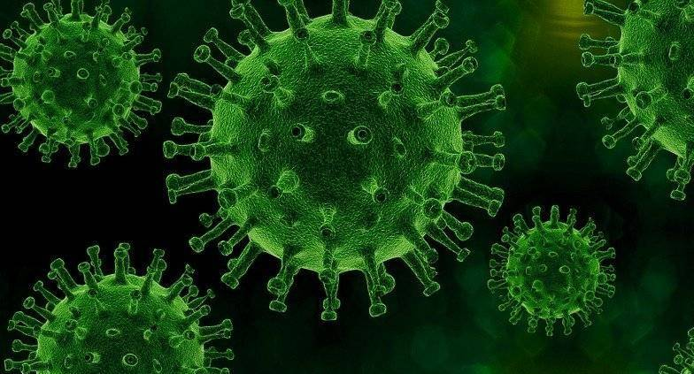


Slide 13
Verzekeringen
Option 1:
No insurance
Option 2:
Bonus-malus
Start in scale 1
Damage ? Next round 2 two scales down
No damage? Next round two scales up
Minimum of 2 weeks!!
Option 3:
Normal insurance
- Premium = 4 sweets a week
Watch out: Risk of theft increases to 2/6
and the premium has gone up
Ronde 3
Schaal: | Premie (in snoepjes):
Schaal 2 | 2
Schaal 1 | 4
0 | 6
Schaal -1 | 8
Schaal -2 | 10
Schaal-3 | 12
Schaal-4 | 14
Schaal-5 | 16

Slide 14
Experiment round 3 & 4
Verzekeringen
Option 1:
No insurance: no premium
Option 2:
Bonus-malus
You start in scale 0
Damage? 2 scales down
No damage? 1 scale up
Minimum of 2 weeks
Option 3:
Ordinary insurance
- Premium = 4 sweets a week
Scale | Premium (in sweets):
Scale2 | 2
Scale 1 | 4
0 | 6
Scale-1 | 8
Scale -2 | 10
Scale -3 | 12
Scale -4 | 14
Scale -5 | 16

Slide 15
Verzekeringen
Round 3
Put your premium on the corner of the table
Option 1:
No insurance
Option 2:
Bonus-malus
Start in scale 1
Damage ? Next round 2 two scales down
No damage? Next round two scales up
Minimum of 2 weeks!!
Option 3:
Normal insurance
- Premium = 4 sweets a week
Schaal: | Premie (in snoepjes):
Schaal 2 | 2
Schaal 1 | 4
0 | 6
Schaal -1 | 8
Schaal -2 | 10
Schaal-3 | 12
Schaal-4 | 14
Schaal-5 | 16

Slide 16
Verzekeringen
Round 3
Roll the dice!
Put the sweets you have to give up on the corner of the table.
Option 1:
No insurance
Option 2:
Bonus-malus
Start in scale 1
Damage ? Next round 2 two scales down
No damage? Next round two scales up
Minimum of 2 weeks!!
Option 3:
Normal insurance
- Premium = 4 sweets a week
Schaal: | Premie (in snoepjes):
Schaal 2 | 2
Schaal 1 | 4
0 | 6
Schaal -1 | 8
Schaal -2 | 10
Schaal-3 | 12
Schaal-4 | 14
Schaal-5 | 16

Slide 17
Verzekeringen
Optie 1:
No insurance
Optie 2: Bonus-malus
Damage ? Next round 2 scales down
No damage ? Next round1 scale up
Optie 3:
Normal insurance
- Premium= 4 sweets a week
LET OP: Risk of theft remains 2/6
Round 4
Put your premium on the corner of the table
Schaal: | Premie (in snoepjes):
Schaal 2 | 2
Schaal 1 | 4
0 | 6
Schaal -1 | 8
Schaal -2 | 10
Schaal-3 | 12
Schaal-4 | 14
Schaal-5 | 16

Slide 18
Verzekeringen
Round 4
Roll the dice!
Put the sweets you have to give up on the corner of the table.
Optie 1:
Niet verzekeren
Optie 2:
Bonus-malus
Beginnen in schaal 0
Schade? Volgende ronde 2 schalen omlaag
Geen schade? Volgende ronde 1 schaal omhoog
Minimaal 2 weken!!
Optie 3:
Normal insurance
- Premie = 4 sweets a week
Schaal: | Premie (in snoepjes):
Schaal 2 | 2
Schaal 1 | 4
0 | 6
Schaal -1 | 8
Schaal -2 | 10
Schaal-3 | 12
Schaal-4 | 14
Schaal-5 | 16

Slide 19

Interviewing the students
What choises were made?
Why didn’t you take an insurance?
Would you make the same decisions next time?
Did the higher risk during the Pandemic influence your behaviour?
Did what you saw happening by your fellow students influence your behaviour?

Slide 20
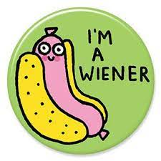
Who won the game?
Who has still got all of the 25 sweets?
More than 20?

Slide 21
Conclusion
Risk
Risk aversion
No insurance
Normal Insurance
Bonus-malus

